Slide 1
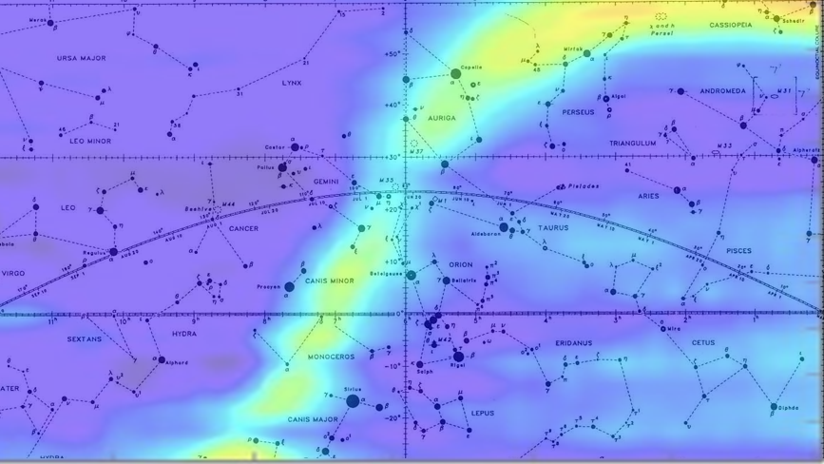
Design and Development of a Software Defined Radio Telescope
By: W. Logan Spooner and Dr. Shantanu Chakraborty

Slide 2
Outline
Background and Premise
Circuit Setup
Horn Antenna Construction
Weather Antenna
Software
Data
Horn Antenna vs Weather Antenna
Issues and Setbacks
Looking Forward

Slide 3
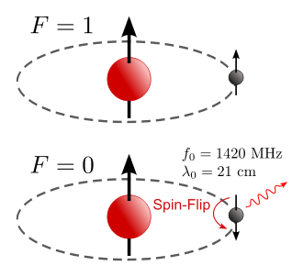
Background and Premise
21 cm wavelength radiation emitted by cold Hydrogen Clouds
Cold Hydrogen is that which makes up most of the Inter Stellar Medium (ISM)
The observation of this helped Astronomers determine the shape and structure of our Galaxy.
We hope to create a telescope capable of observing this using a Software Defined Radio

Slide 4
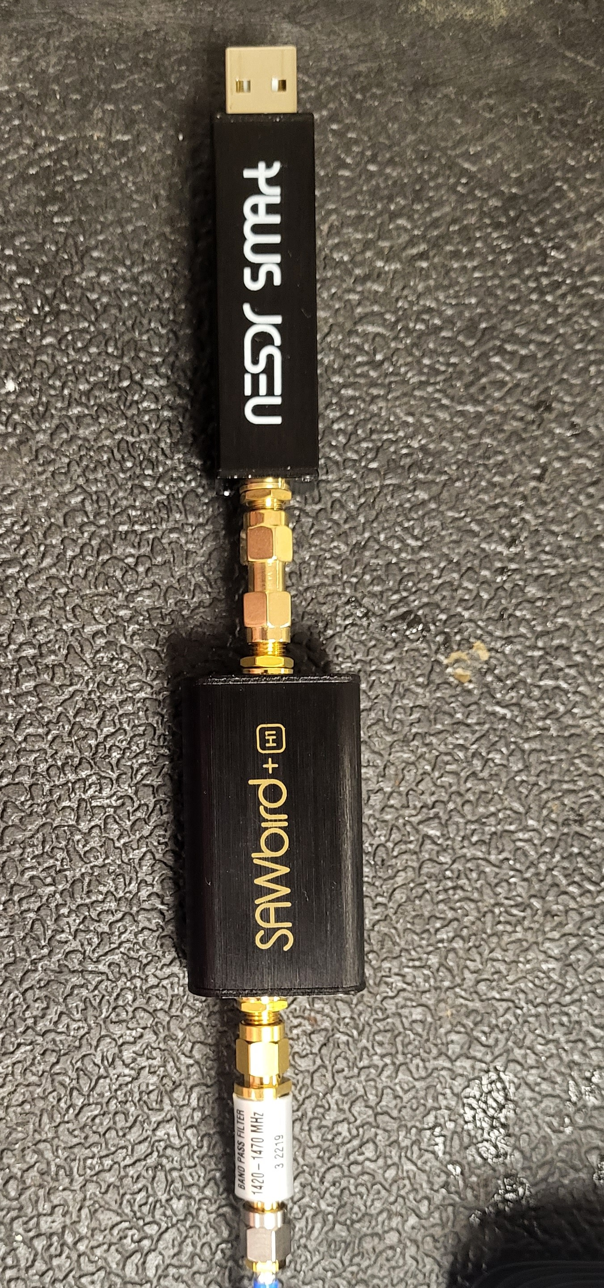
Circuit Design
1420 MHz BPF
SDR circuit consisted of 4 parts
The Antenna and feedline to collect and focus the information
A Bandpass filter (BPF) to filter out unwanted frequency bands
A Low Noise Amplifier (LNA) to amplify our target frequency
An RTL-SDR to allow the analysis of the data on a laptop using SDRSharp
LNA
RTL-SDR

Slide 5
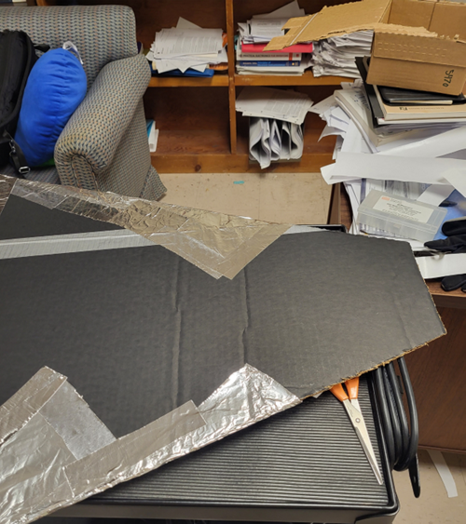
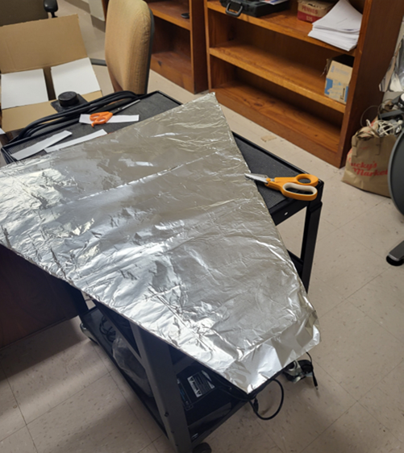
Horn Antenna Construction
Design comes from American Astronomical Society, AAS Meeting #224, id.415.01
Dimensions used to optimize size while still being convenient to move
Construction:
Used a 9”x6”x4” can as the waveguide.
5.3 cm piece of copper wire for feed line
Cut cardboard into shape and wrapped with aluminum foil.
Taped everything together with aluminum conducting tape.

Slide 6
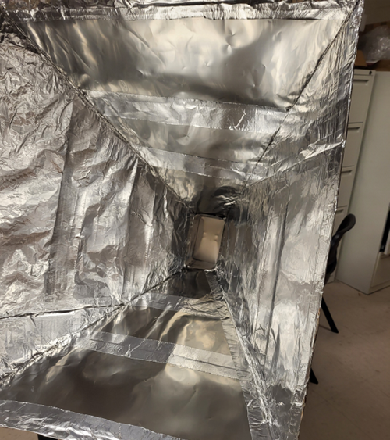
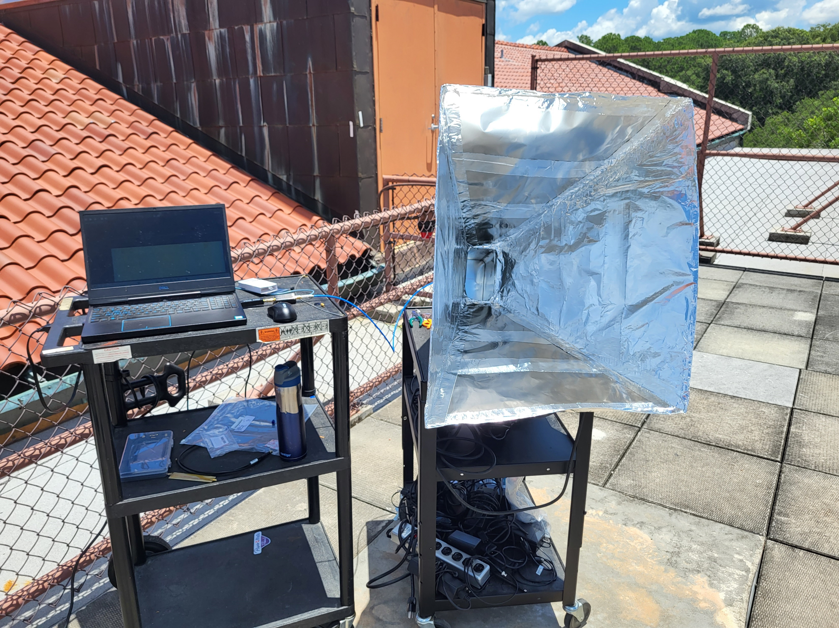
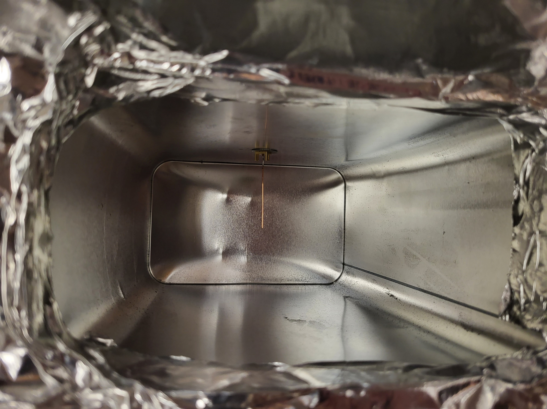
Horn Antenna Construction

Slide 7
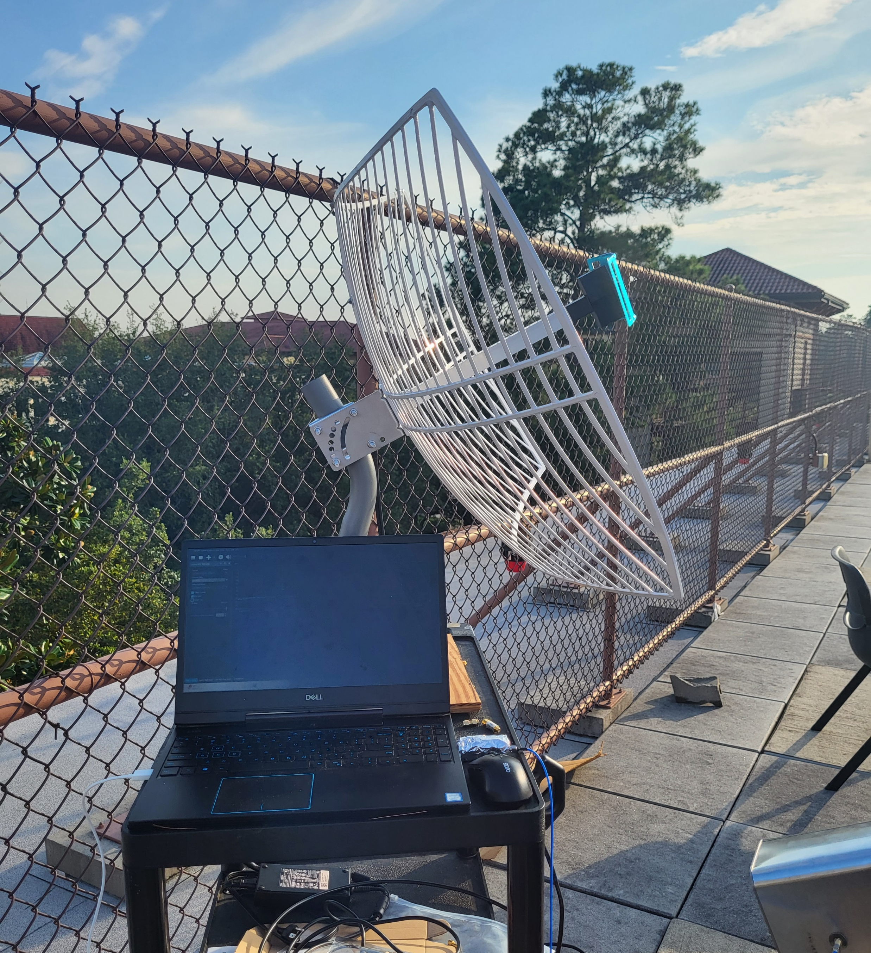
Weather Antenna
Noelec GOES Weather Satellite Parabolic Antenna
1.7GHz Center Frequency
200 MHz+ Bandwidth

Slide 8
Software
All free open-source software used for creating software defined radios
Limited in their use for radio astronomy
Used SDRSharp (SDR#)
Easy UI and simple display
Limited scope and data collection
SDRAngel was another option
Included data save option, didn’t work properly
More complicated UI

Slide 9
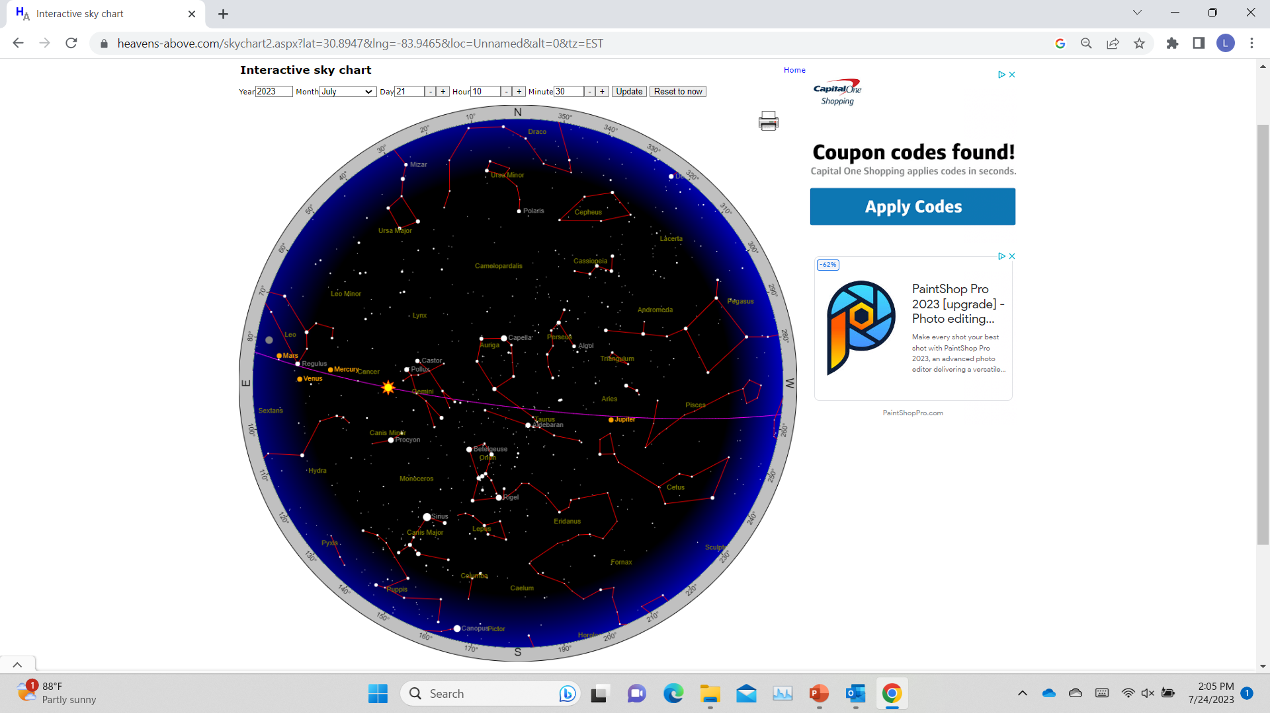
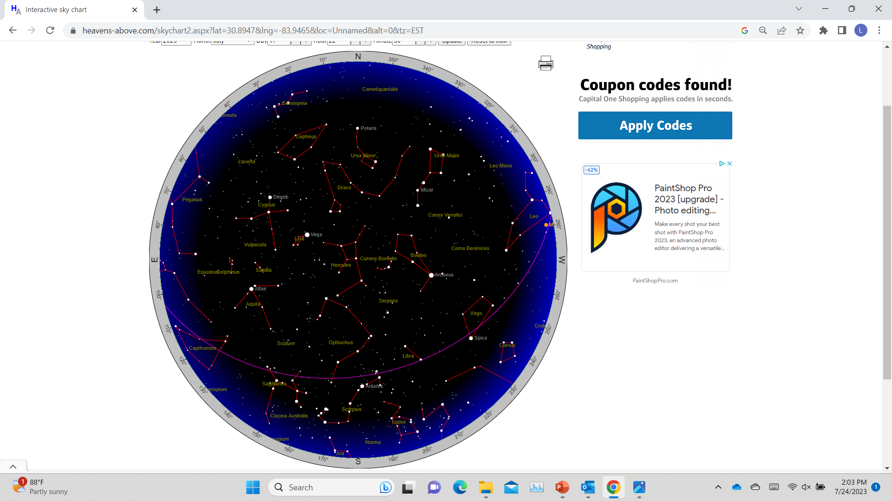
Observation Conditions
Location: Nevins Hall roof, Valdosta State University, Valdosta, Ga.
30.84847916421404, -83.28885987900686
Weather: Varied, mostly Sunny
Time: 10:30 EST and 22:30 EST
10:30 EST
22:30 EST

Slide 10
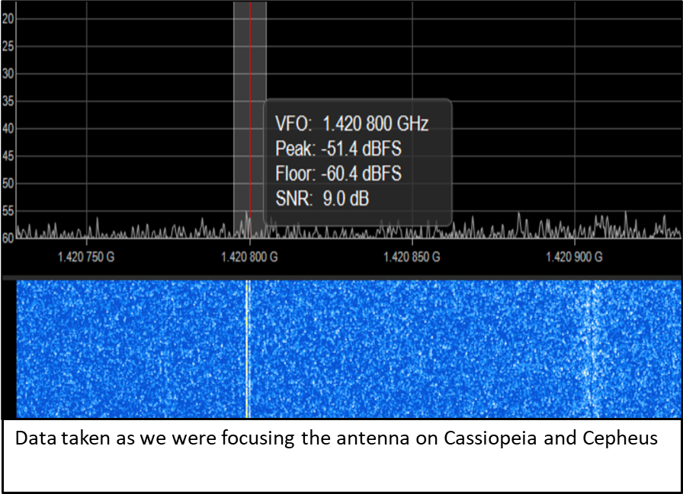
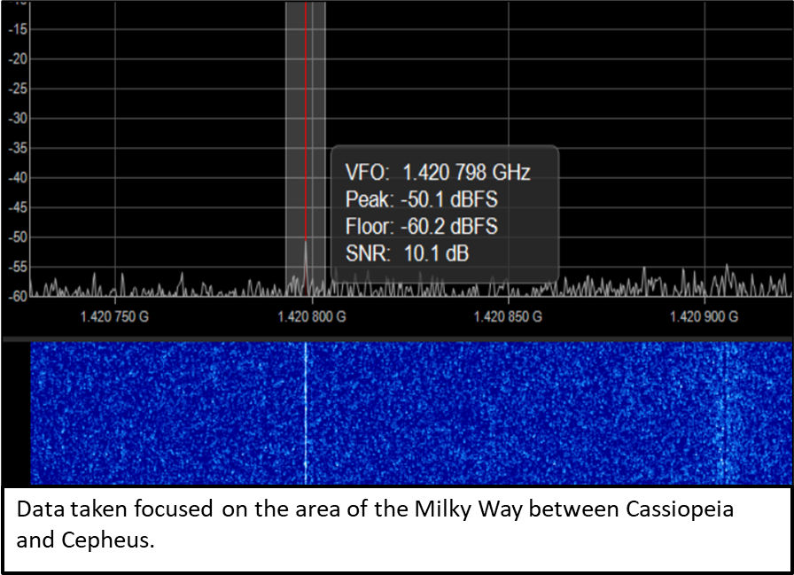
Horn Antenna at Night

Slide 11
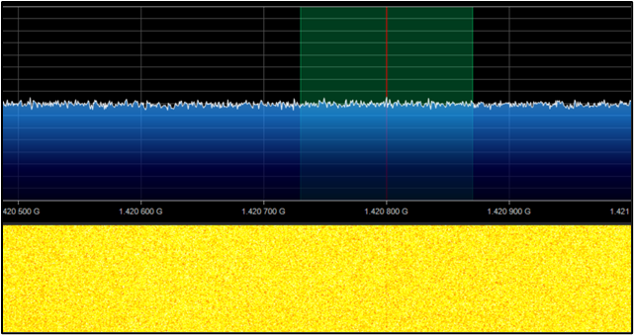
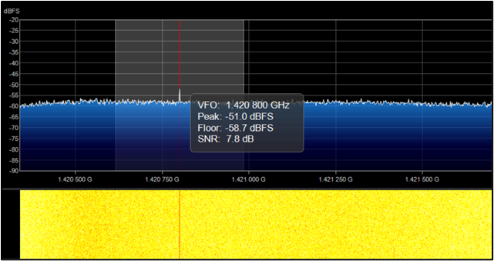
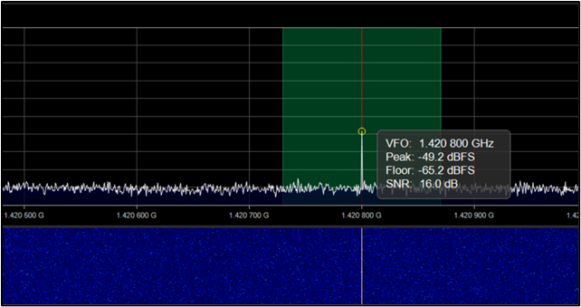
Data: Horn Antenna in the Morning
Data as we moved away from target region.
Data from horn antenna pointed near target region.
Data when antenna was directly on our target region

Slide 12
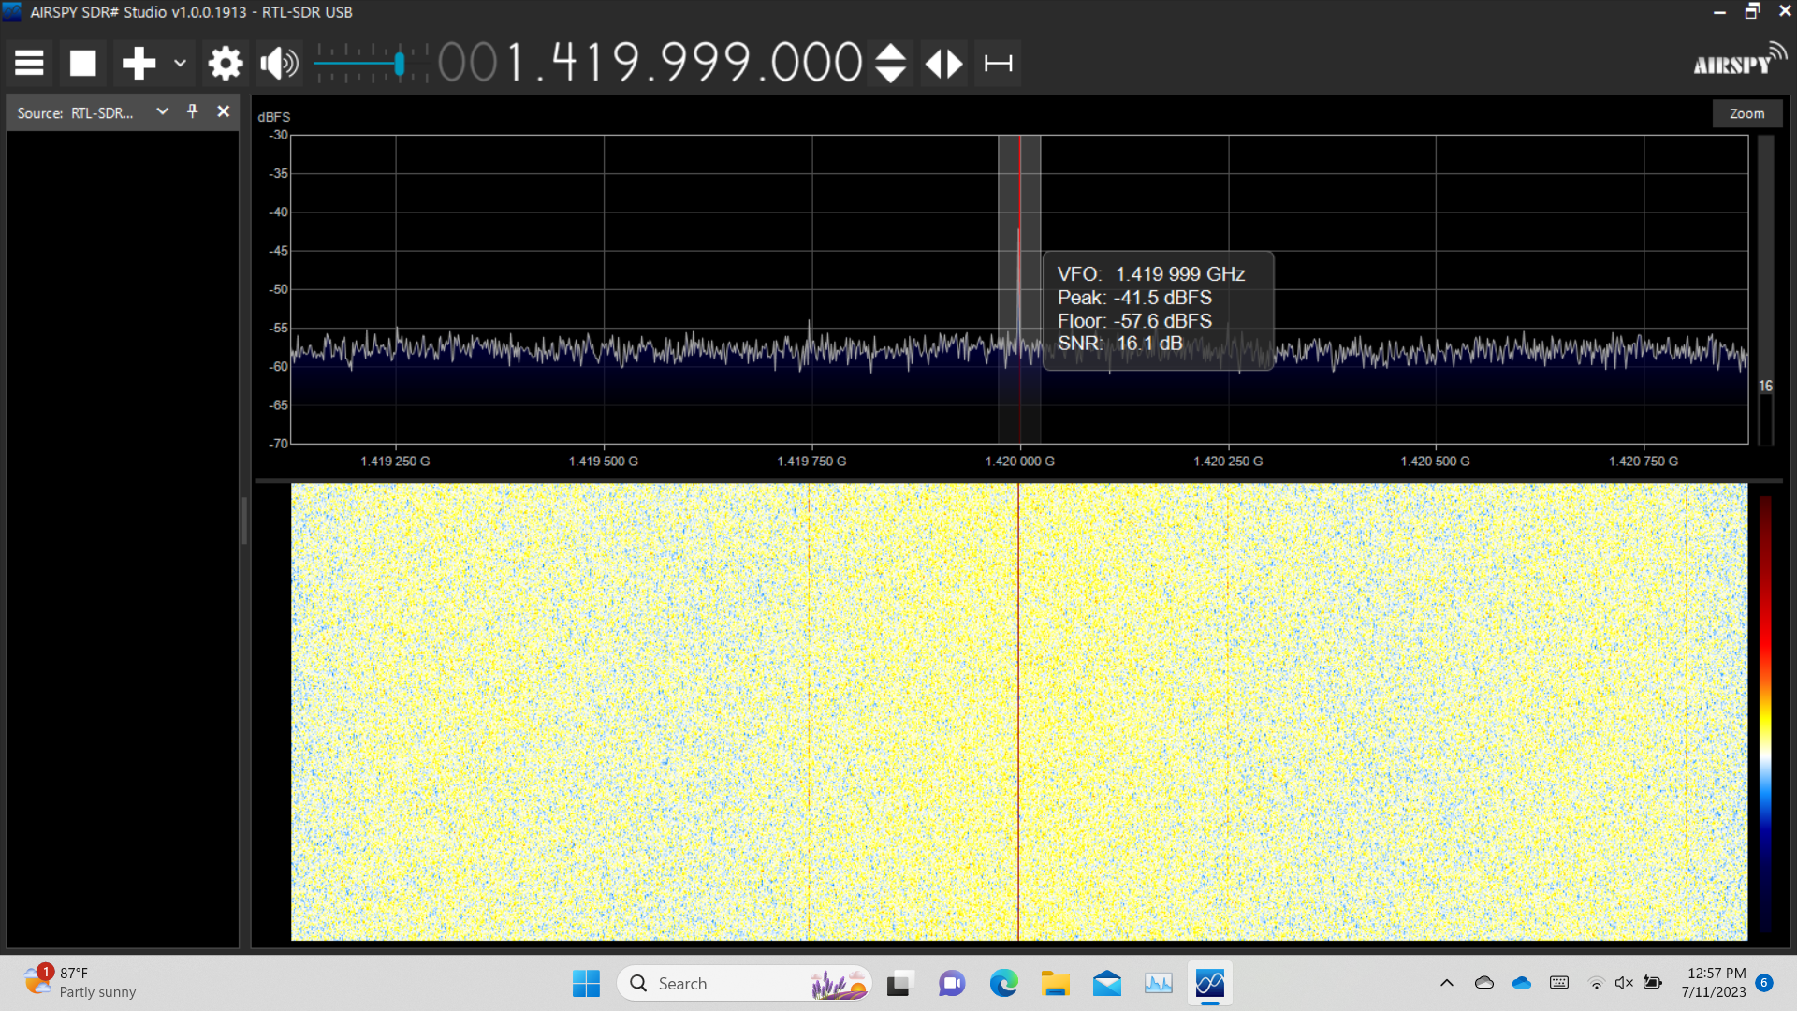
Data: Weather Antenna

Slide 13
Horn Antenna vs Weather Antenna
Horn Antenna
Weather Antenna
Pros
Directional
Optimized for 1420 MHz band
More customizable
Cons
Lower gain
Harder direction control (no mount)
Pros
Higher gain
Easier direction control (came with a mount)
Cons
Wider beam angle
Not optimized for 1420 MHz
Less consistent data

Slide 14
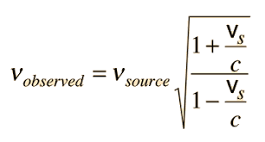
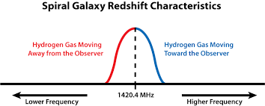
Setbacks and Limitations
Possible reflection sources
Software
Crashes/file issues
No obvious ways to integrate signal over time
Hardware
RTL-SDR heating
Angle measurement
Weather Conditions
Blue/Red shift

Slide 15
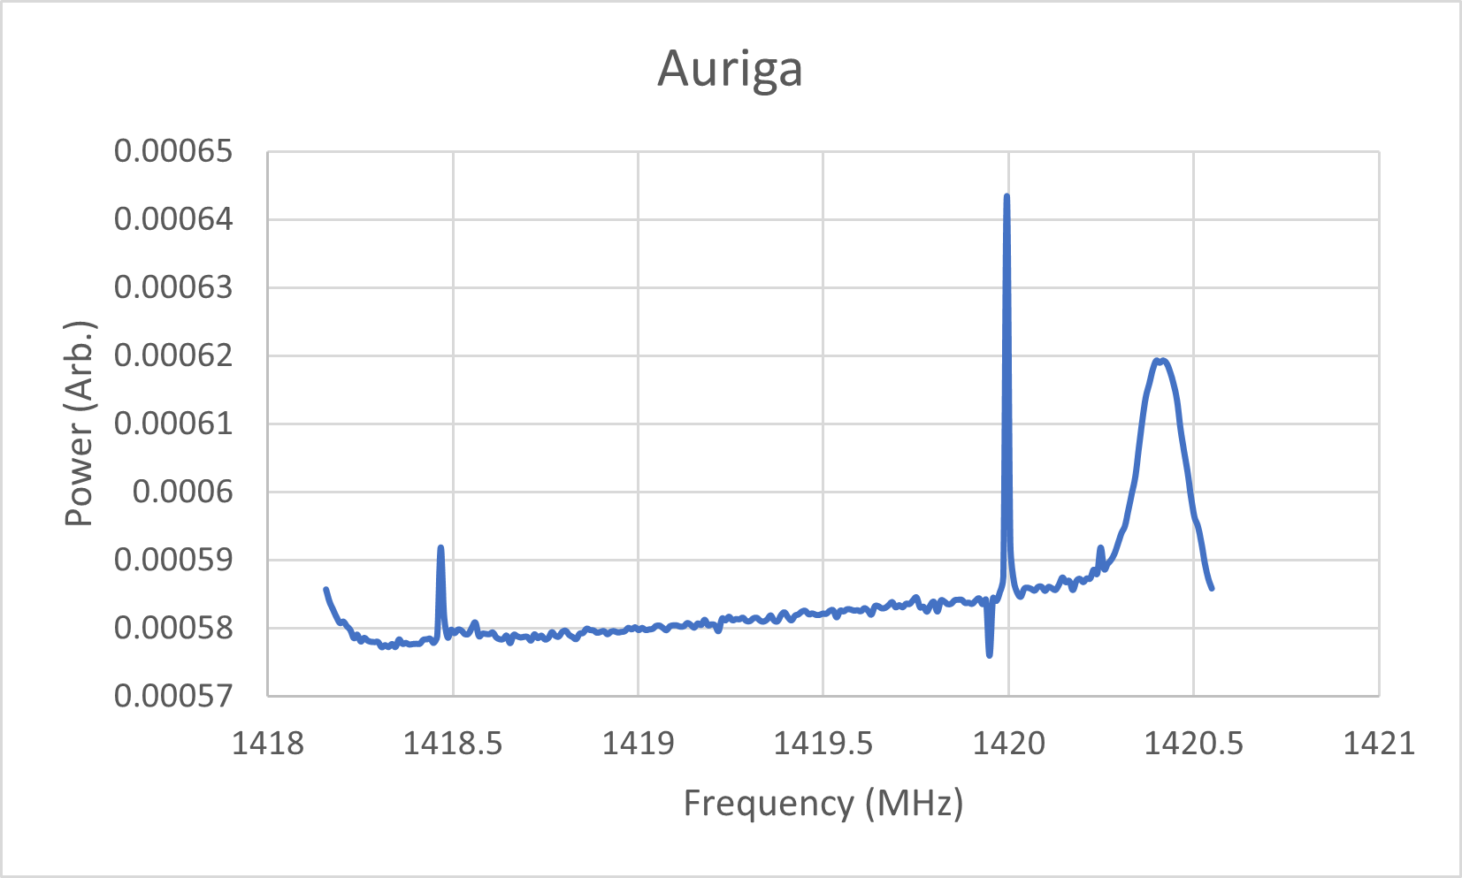
Looking Forward
Software
Found plugin to perform FFT (Fast Fourier Transform) of audio signal and save as Power vs Frequency
Hardware
Parabolic dish antenna
Larger/more precise horn antenna
Mount with Altazimuth coordinates
Observations
More open locations
Other regions of the sky such as Cygnus and Sagittarius

Slide 16
References
https://en.wikipedia.org/wiki/Hydrogen_line
http://hyperphysics.phy-astr.gsu.edu/hbase/Relativ/reldop2.html
https://www.heavens-above.com/
http://www.ccera.ca/papers/memo-0011-a-21cm-map-of-the-northern-sky/
https://radio-astronomy.org/node/191
http://mercury.pr.erau.edu/~prcphysics/observatory/hydrogen.htm

